Slide 1

Recreating Romance with Sentiment analysis
Roisin O’Donnell

Slide 2
Research Question
Can Sentiment Analysis be used to map the love triangle in Catherine Doyle’s Blood for Blood series?

Slide 3
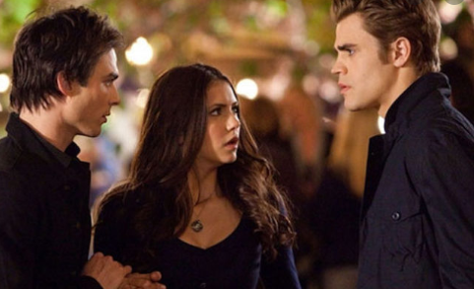



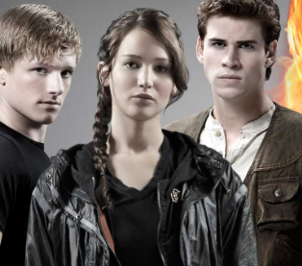
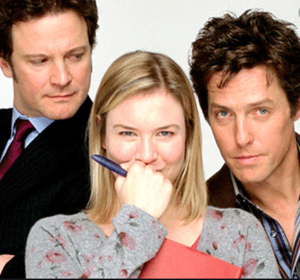
What a love triangle is…

Slide 4



Dataset

Slide 5
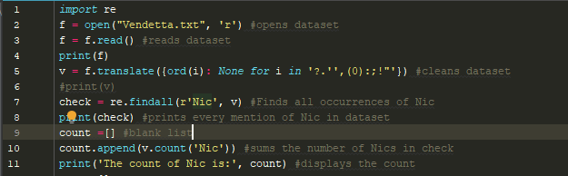
The name finder and counter

Slide 6

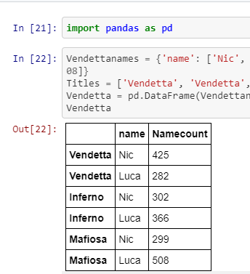
Name Occurrence
Using names of the characters the protagonist is in the Love Triangle with.
Nic and Luca
Book by book recreating the narrative and obsessions that make up the story.

Slide 7
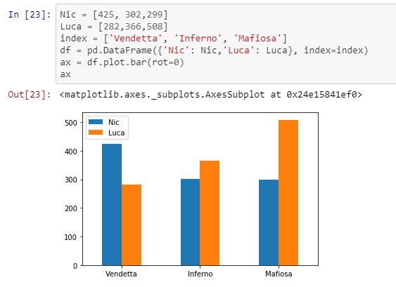
Name Occurrence
Visualizing this data by book.

Slide 8
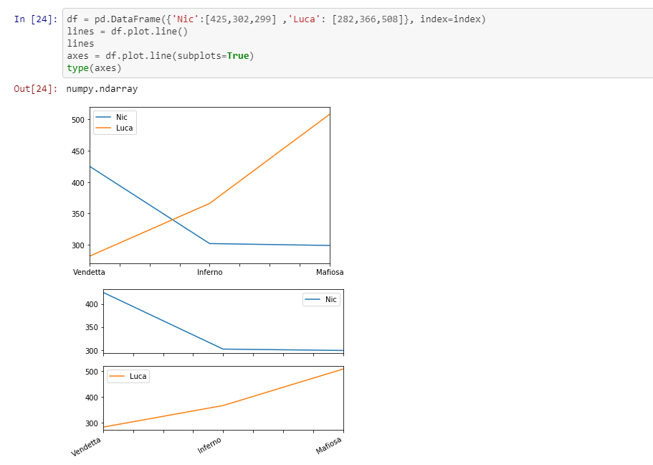
Name Occurrence
Graphing the names against each other.

Slide 9
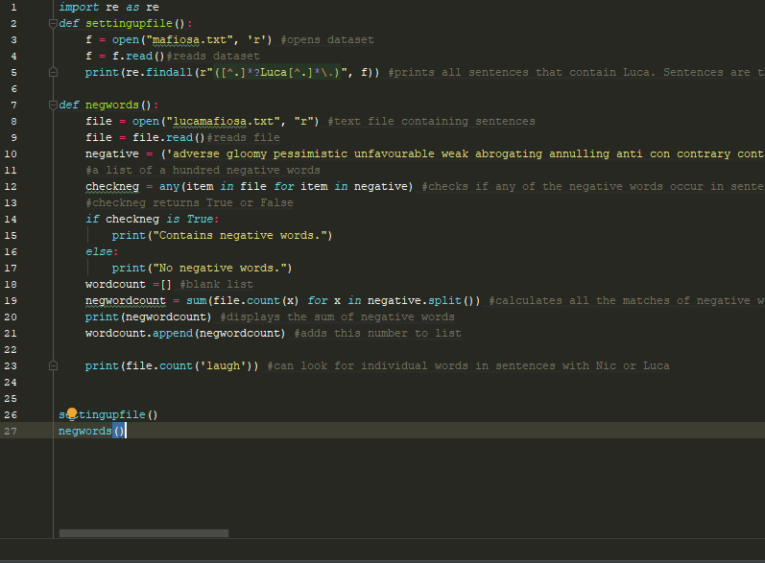
Finding negative words
My Python Program

Slide 10
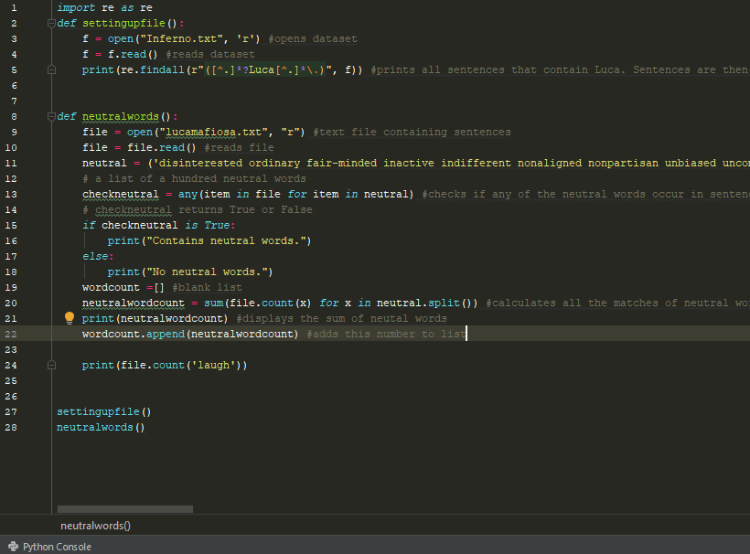
Finding Neutral Words
My Python Program

Slide 11
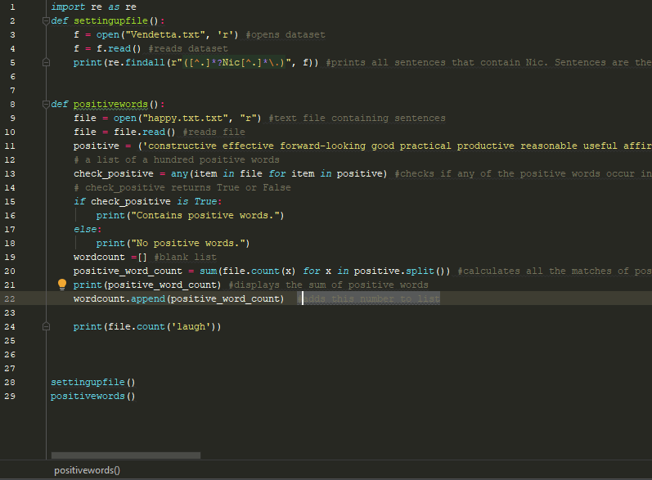
Finding Positive Words
My Python Program

Slide 12
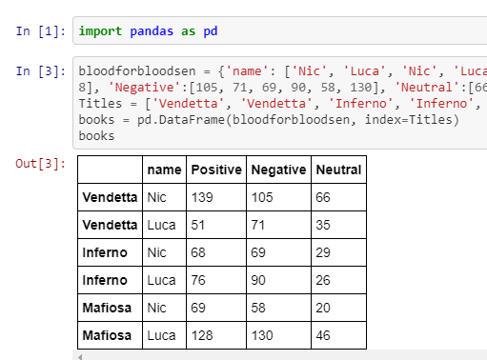
Findings

Slide 13
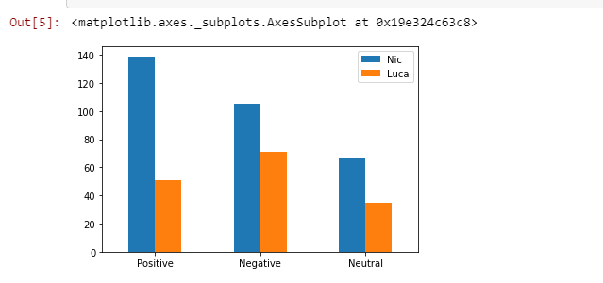
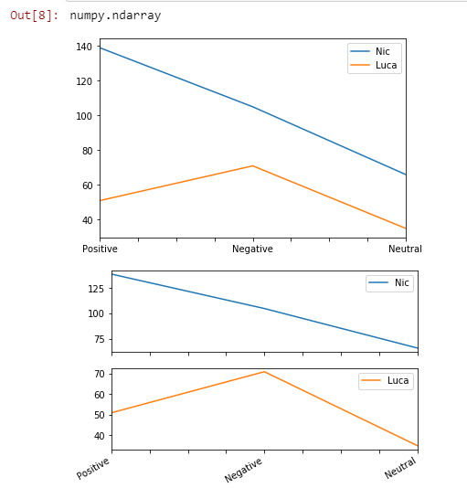

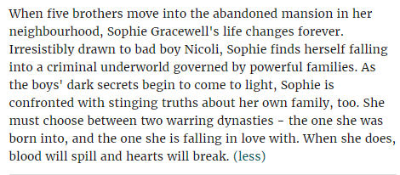

Slide 14
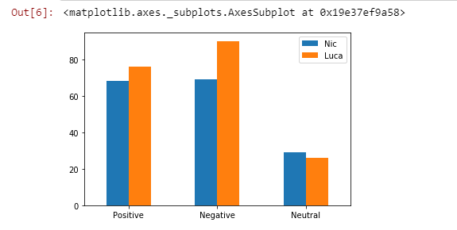
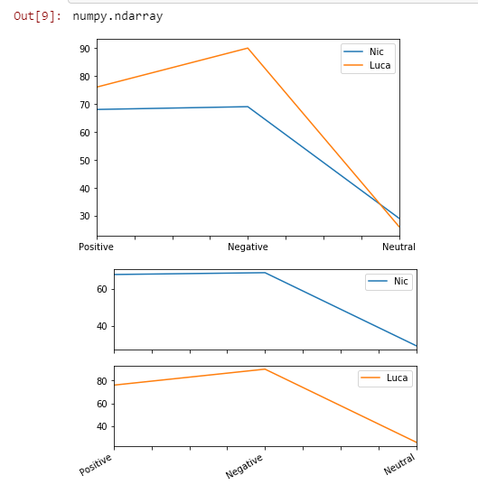
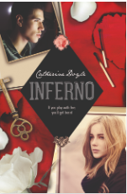
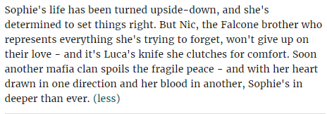

Slide 15
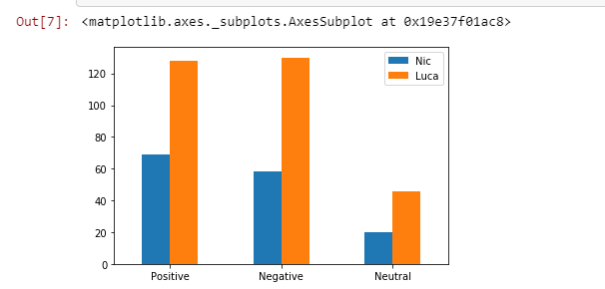
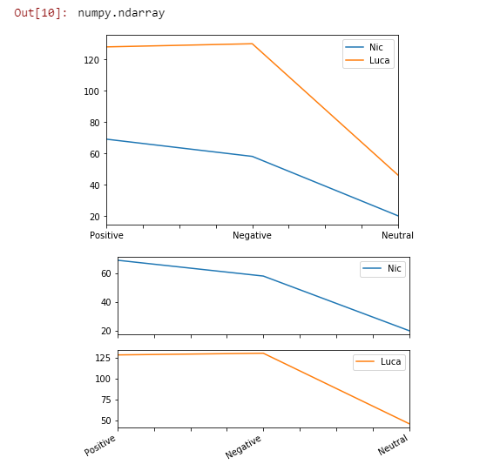
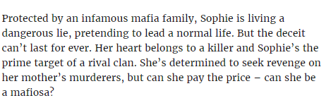


Slide 16


